Slide 1
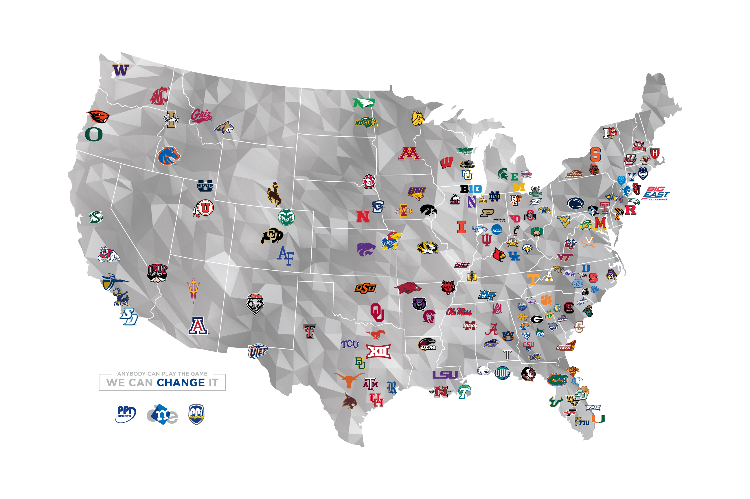
DME Collegiate Area of Influence

Slide 2
DME CAPABILITIES
11-acre Florida complex
500+ employees / over 20 departments
120,000 square ft. of office and warehouse space
Total In-House Marketing Solutions
Creative Development
Offset and Variable Laser Printing
Live Call Center
HD Video Soundstage with Live Webcast Ability
Internet Presence & Social Media Marketing

Slide 3

Marketing Complexity
Notes:
Its complicated Data rules integrated customized campaigns

Slide 4
How Important IS…
Revenue Growth
Your Customers?
How do you presently communicate with your customers?
How important is your sales force?
What is the purpose of your company’s web site?
How do you presently handle response on your advertising campaigns?
Tell me about the programs that have not worked for you in the past two years
Tell me about what is presently working for you.
Who are your main competitors?
The Powerball Lottery this week is worth 252 million. Which is more likely to happen, you pick all 6 numbers correctly or provide me with a detailed report of all your marketing campaign results from the past two years.

Slide 5
Brainstorm
Groups can bring out the best in people and there are a variety of ways to leverage groups:
Have “timed” Brainstorming sessions
Generate as many ideas as possible – no judging or analysis is allowed!
Bring employees specially “Weird Ones” in from other areas of the company for a fresh perspective and creative thought.
The Facilitator needs to encourage people to build on each others ideas

Slide 6
Allow Failure!
Innovative thinking can be risky
Some Ideas generated will be the best…
some will be awful…be careful
For innovation to work, you have to learn from the failures and applaud the successes. As well as the failures. The failures paved the way to success.

Slide 7
Action Items
All employees are now in sales and have business cards and email addresses.
Redo compensation plans. Compensation directs behavior.
Change job descriptions for at least 20% of your staff Immediately
Partner with Best of Class Companies (find 2 new partners by October 15)
Focus on Outcome and Solutions
Promote Results not Propaganda
Encourage Innovation and throw out Tinkering
If its going to happen eventually let it happen immediately. Bad does not cure itself. Make tough decisions today not tomorrow
Recruit Word Class People
Reward Top Performers, recruit and reward Innovators
Be Paranoid, be greedy, Reinvent, decentralize, disorganize.

Slide 8
Action Items
Identify Your Value Proposition
Create a Presentation Video Animation
Utilize it
Create a Personal Web site
Simplify Your Company Web site
Populate at least 6 Social Media Sites
Create New Business Cards

Slide 9
Avoid Mediocrity
Use a winning strategy – pay attention to all good ideas, all the details, all the “Weird People.”
Defending Mediocrity is exhausting. Yet the organizations that need to innovate the most also fight it the most. They love “status quo” and love thinking they can freeze time.

