Slide 1
P3
Public/Private Partnerships
Facilitating Graphic Communications & Technology Strategies
Robert Wheatley, Office Depot
Andrew Kniberg, Office Depot
Mike Panaggio, Consultant
06.14.17

Slide 2
KNOW YOUR GOALS & THE CHALLENGE BEGINS
Define/address & pivot ‘challenges’
Review strategic roadmap
Complementing Marketing/Communications
Campaign/Data/Messaging
Planning/Automation & Analytics
Execution
Identification of solutions
Operationalizing the final product
Content management webx
https://youtu.be/IPAkkHtfZEM
2

Slide 3
DEFINE/REDEFINE & PIVOT
What were the challenges we set out to solve for ?
Listen & learn from each other
Embraced engagement model (Extension needs & what OD brings)
Multiple stakeholders w/different goals & challenges
What have we accomplished together?
Supply chain enhancements, Robust CMS/Storefront & Integrated Marketing
Driven/redirect funds back into programming
Brand continuity and content customization
Quality & selection of product enhancement
Future Initiatives
Revenue generation and cost recovery
Data driven decisions
E-Publishing
Dynamic education/awareness campaigns
3

Slide 4
STRATEGIC ROADMAP
Six Sigma Due Diligence
Defined Statement of Work
Training & Education
Snapshot of Current State
ROI Proposal
Implementation
4

Slide 5
STRATEGIC PARTNERSHIPS
You now have a distinct advantage!
Establishing relationships with companies with specific best-in-class services offers a distinct advantage. Three major advantages include:
Your organization’s output is increased
You inherit the strengths and capabilities of your strategic partner(s)
You can pick and choose the right partner(s) to compliment your team
DATA SERVICES
DIGITAL SERVICES
PRINT SERVICES
MAILING SERVICES
FULFILLMENT SERVICES
5

Slide 6
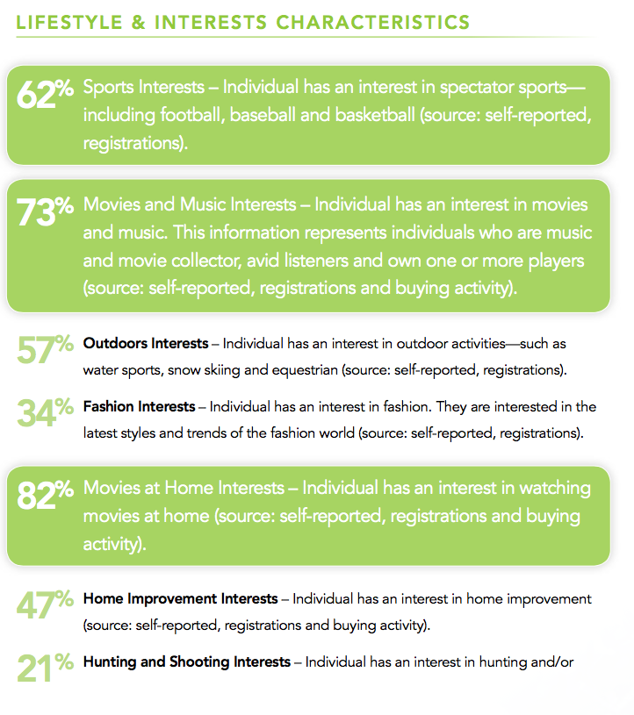
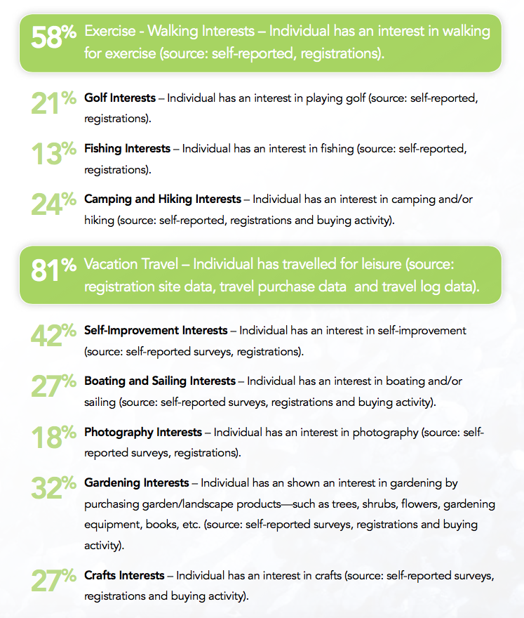
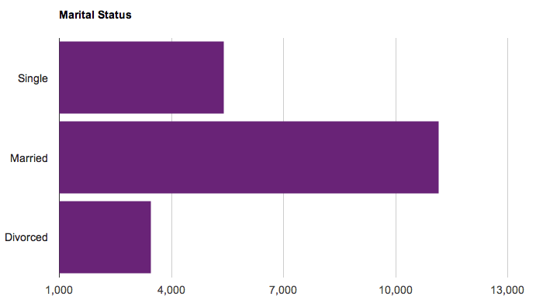
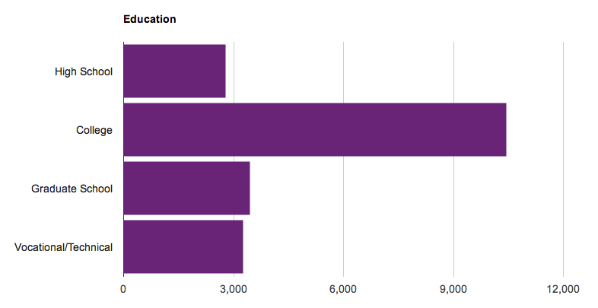
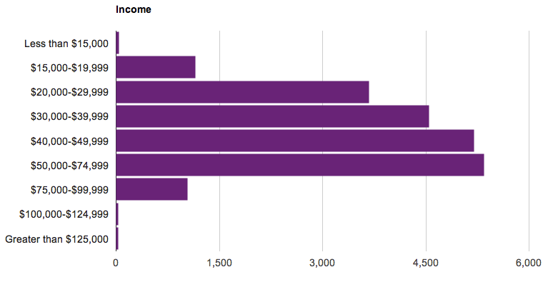
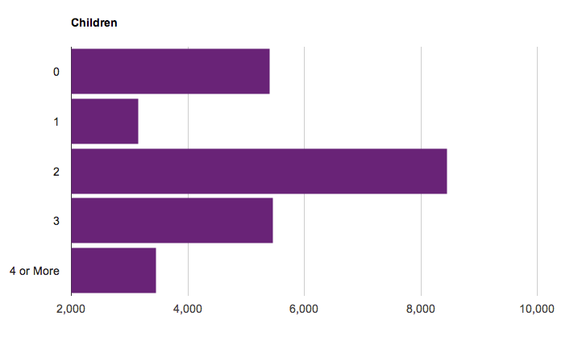
STRATEGIC INSIGHTS
“Technology exists today that can help you gain a much deeper insight into your target audience.”
Whether at an individual level, or a household level, demographic and psychographic data is available to help you understand lifestyle interests, hobbies and buying habits.”
6

Slide 7
EVERY ORGANIZATION’S GOAL
(or at least it should be)
Sustainable. Revenue. Growth.
7

Slide 8
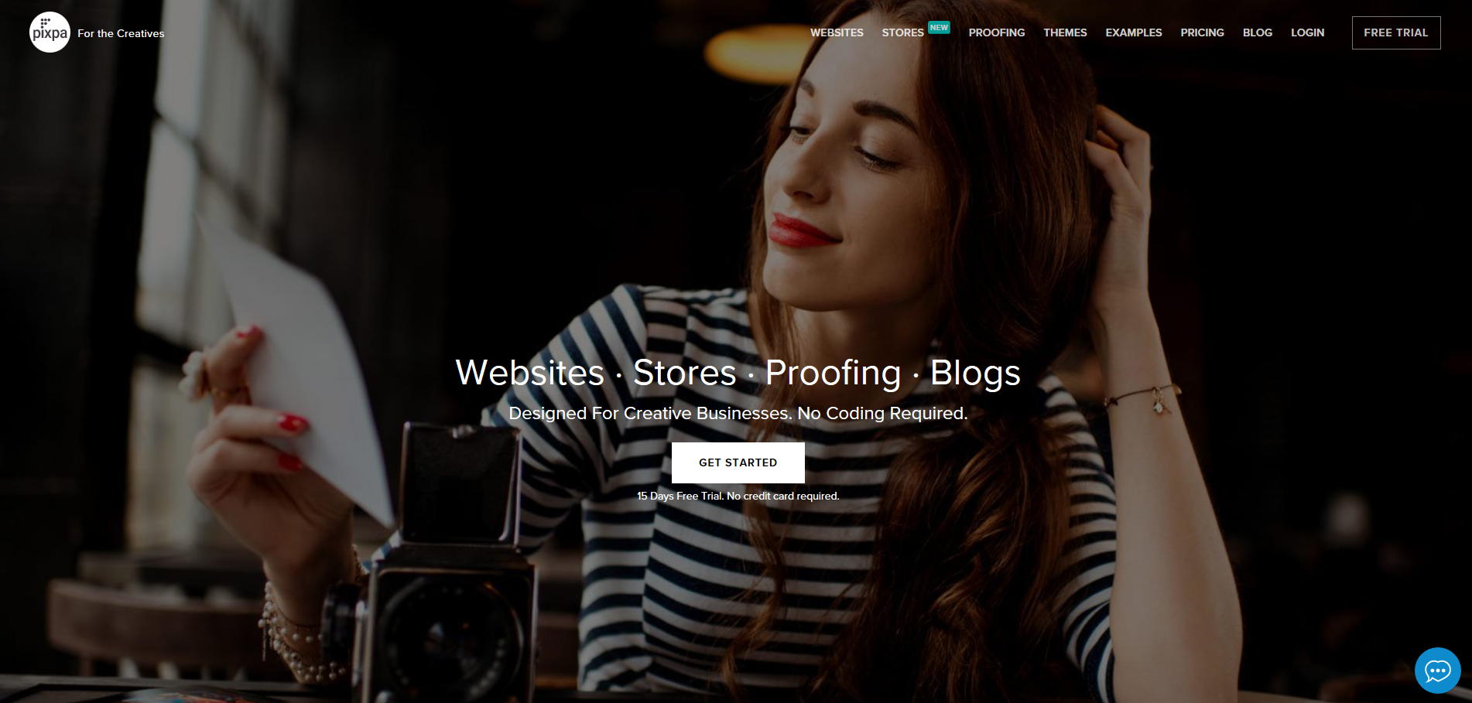
Categorize & map content (by program) end user consumer and county offices
Support collection/management and publishing material
Maintain content and brand identity consistency
Shared resources to distribute work load
Robust analytics and reporting
8

Slide 9
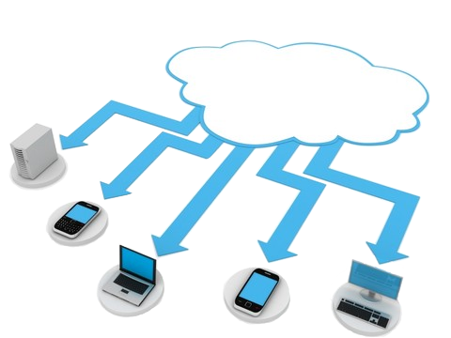
CONTENT DELIVERY NETWORK
Customizable storefront
Pre-printed, on demand and online dissemination
Print & E-Pub
Data driven inventory management (print & promo)
One platform for internal and external offerings
Scalable for shifting directives
9

Slide 10
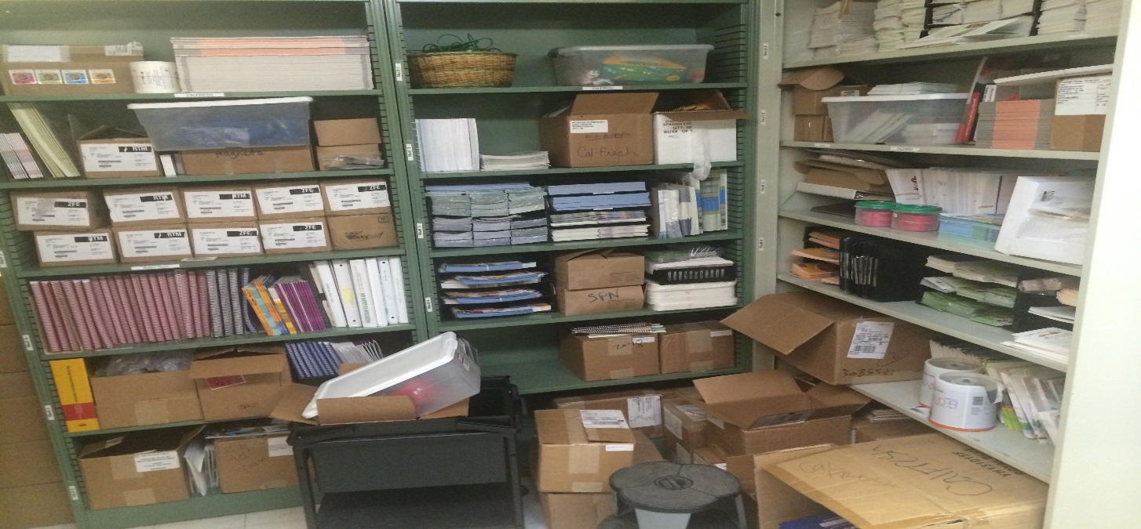
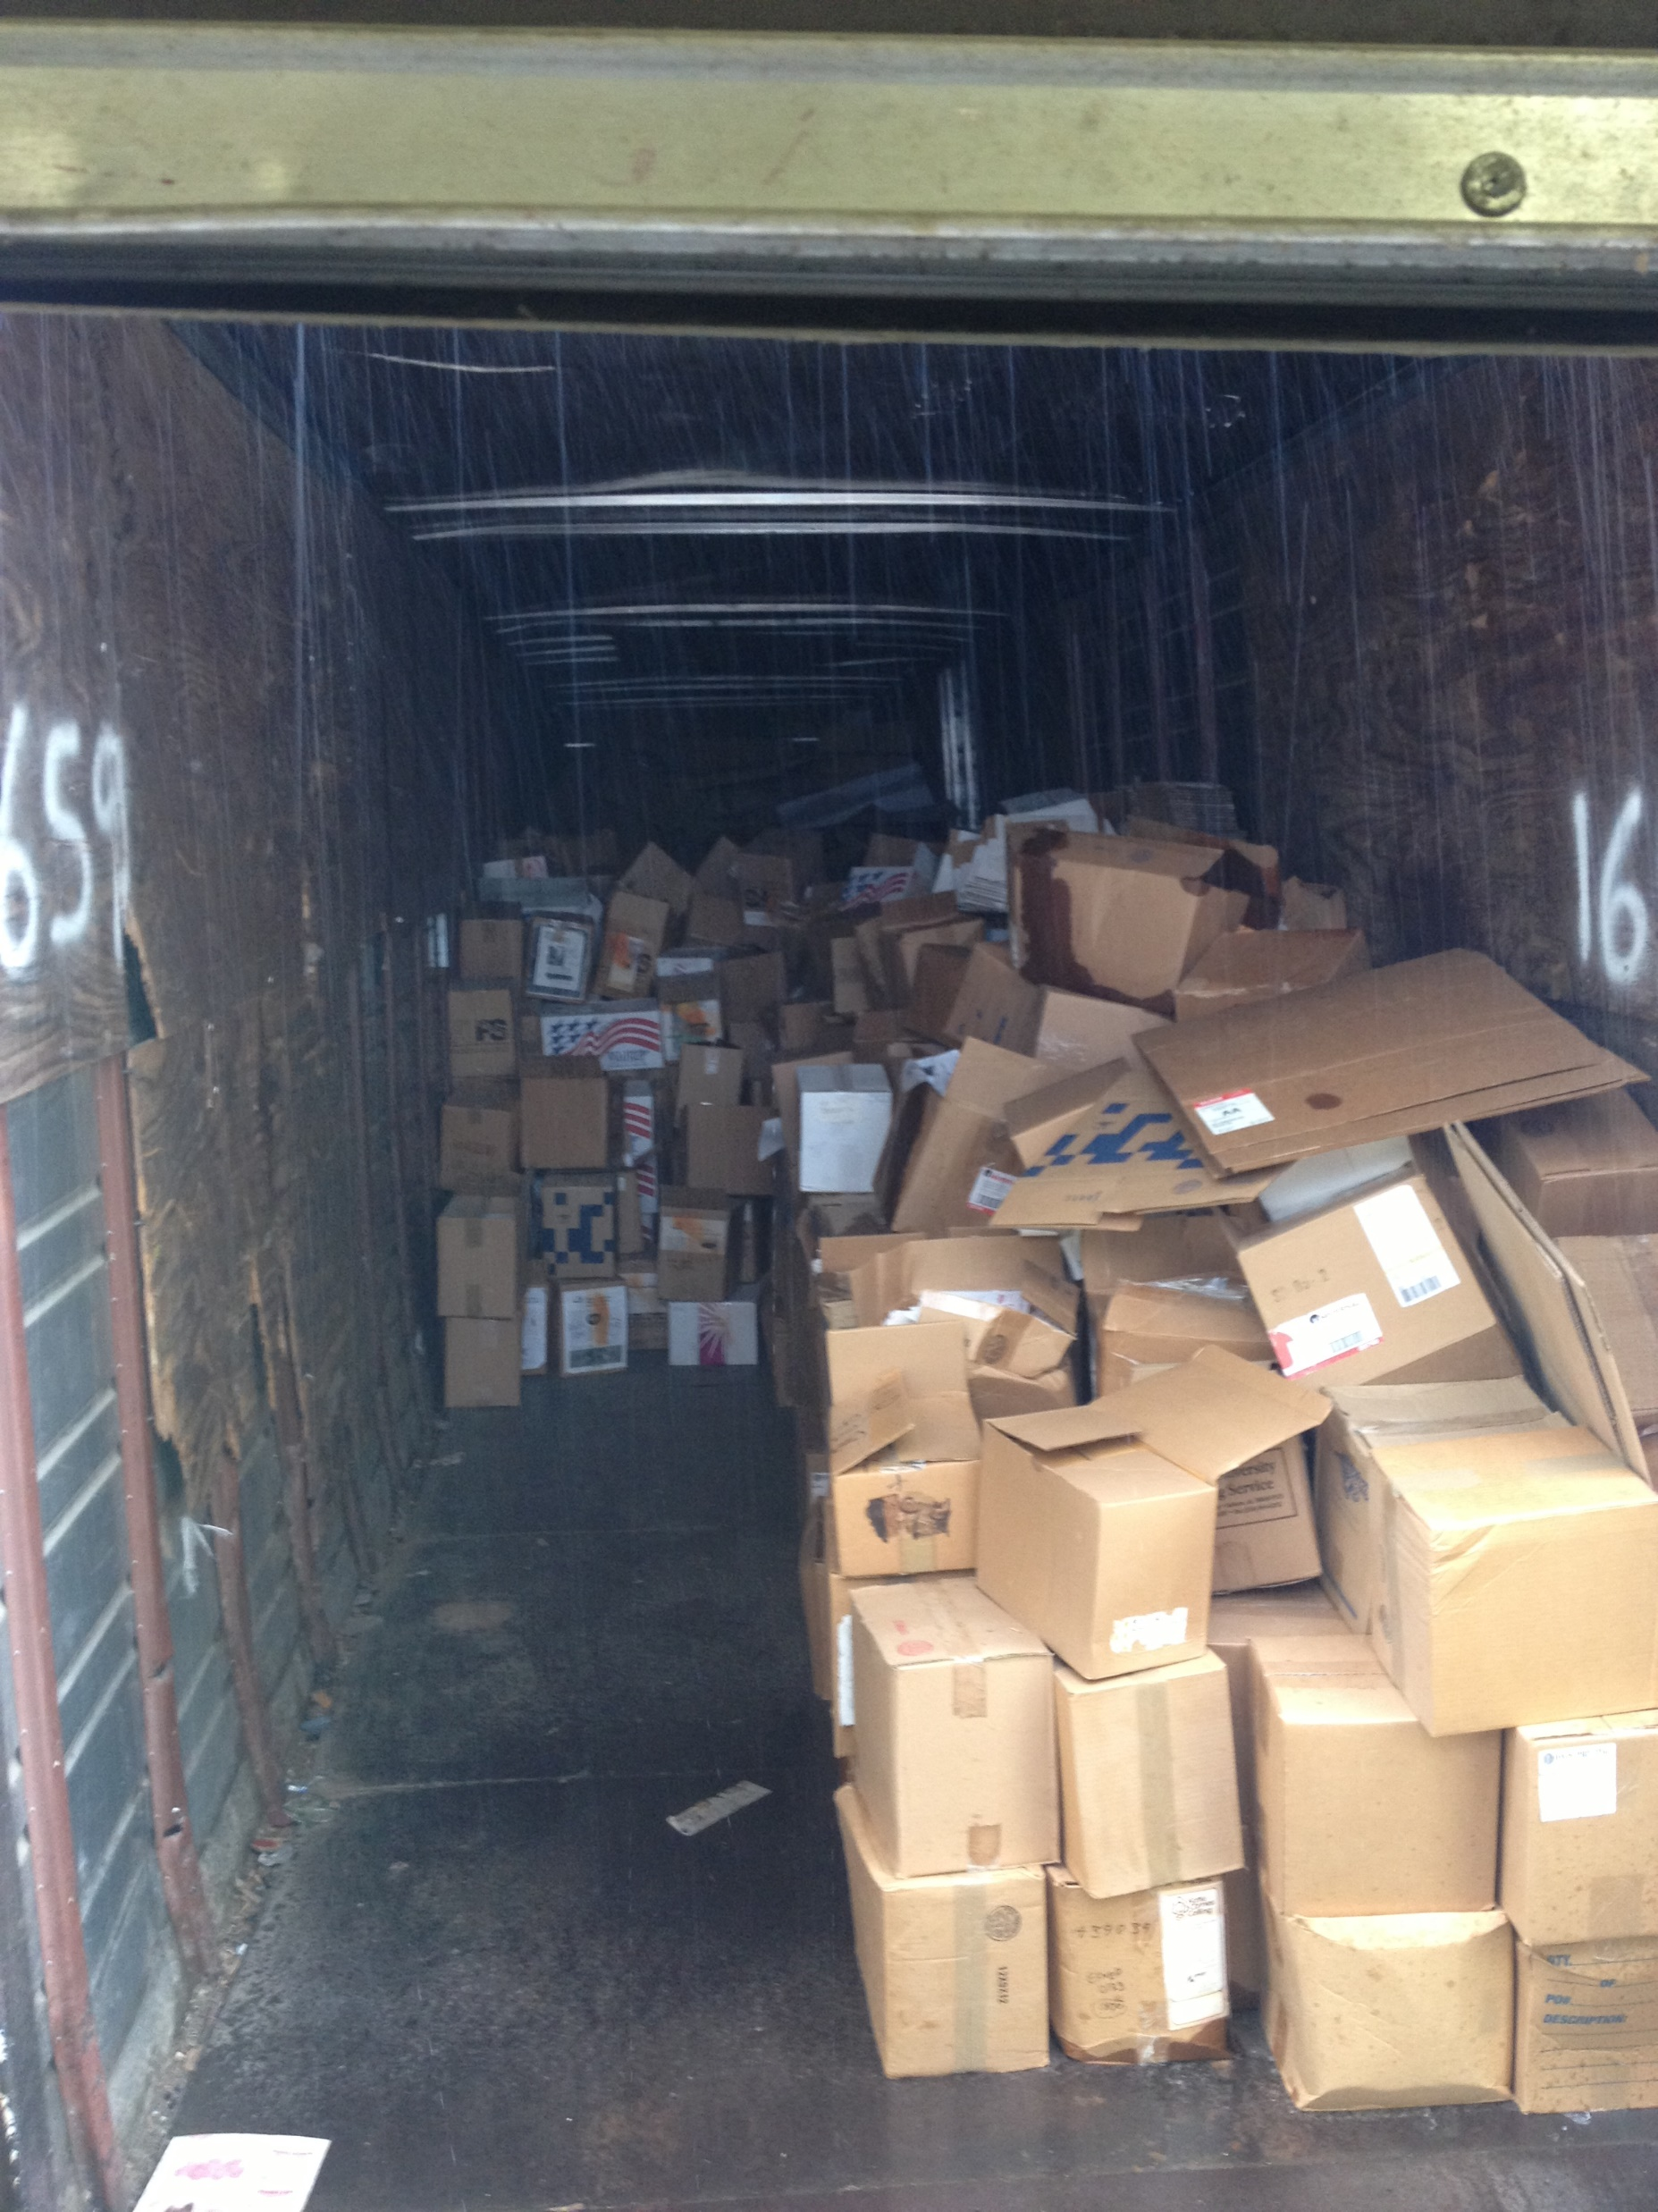
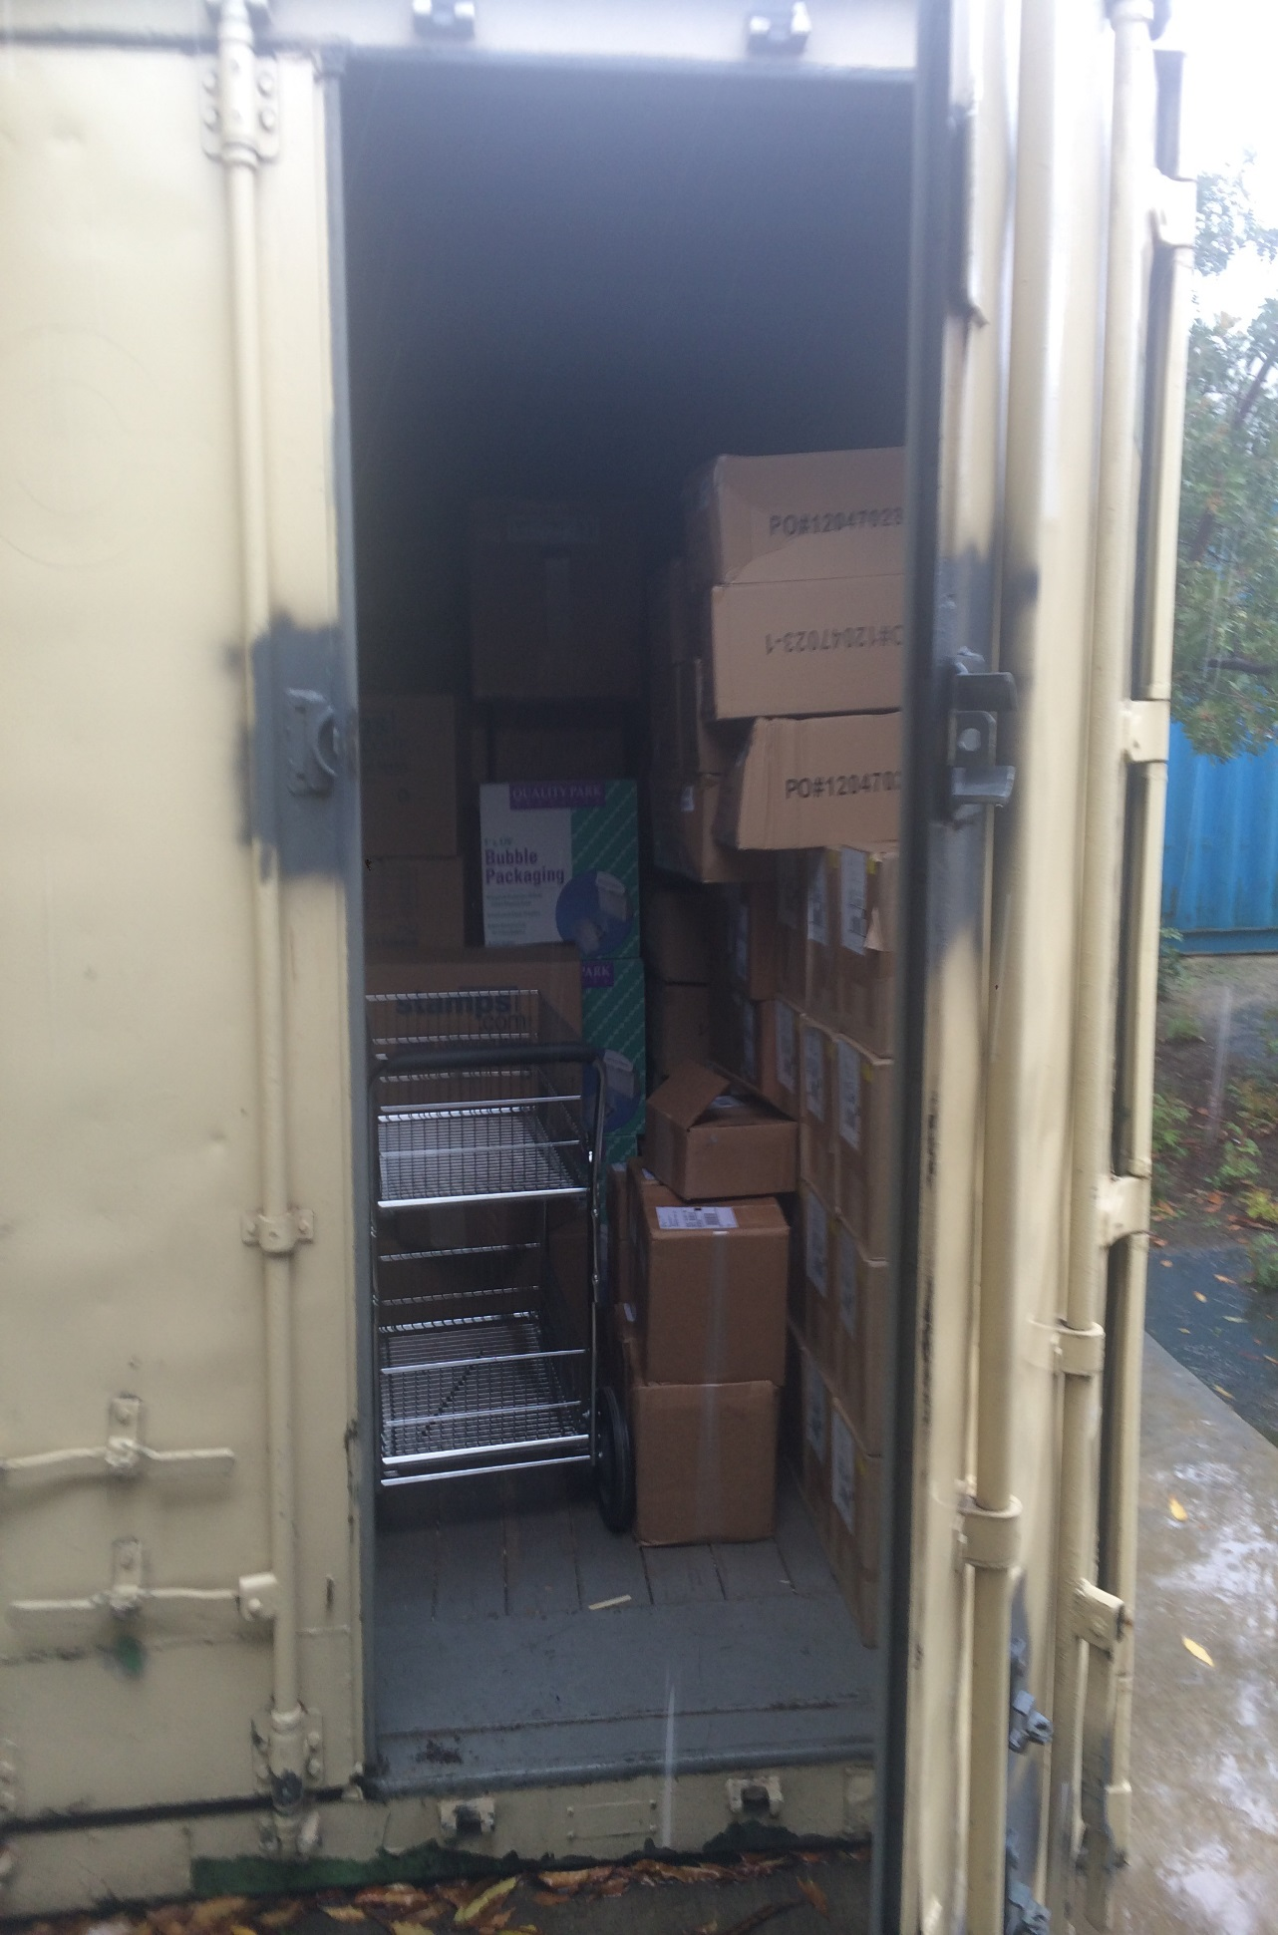
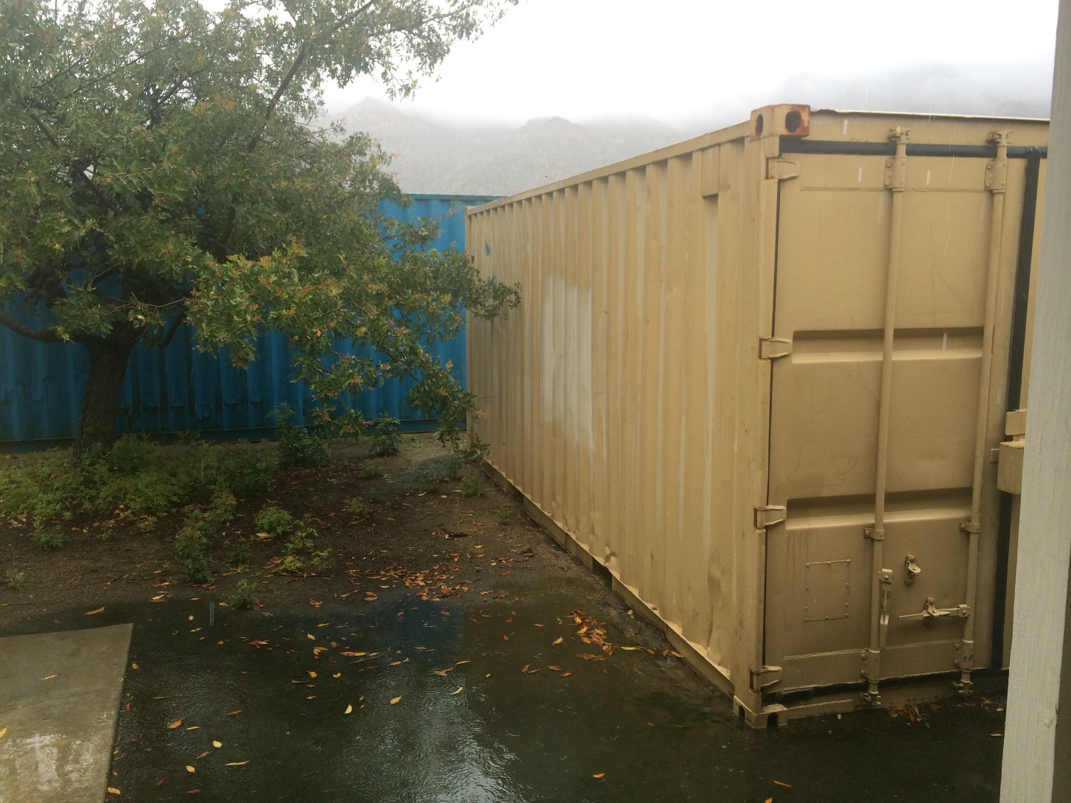
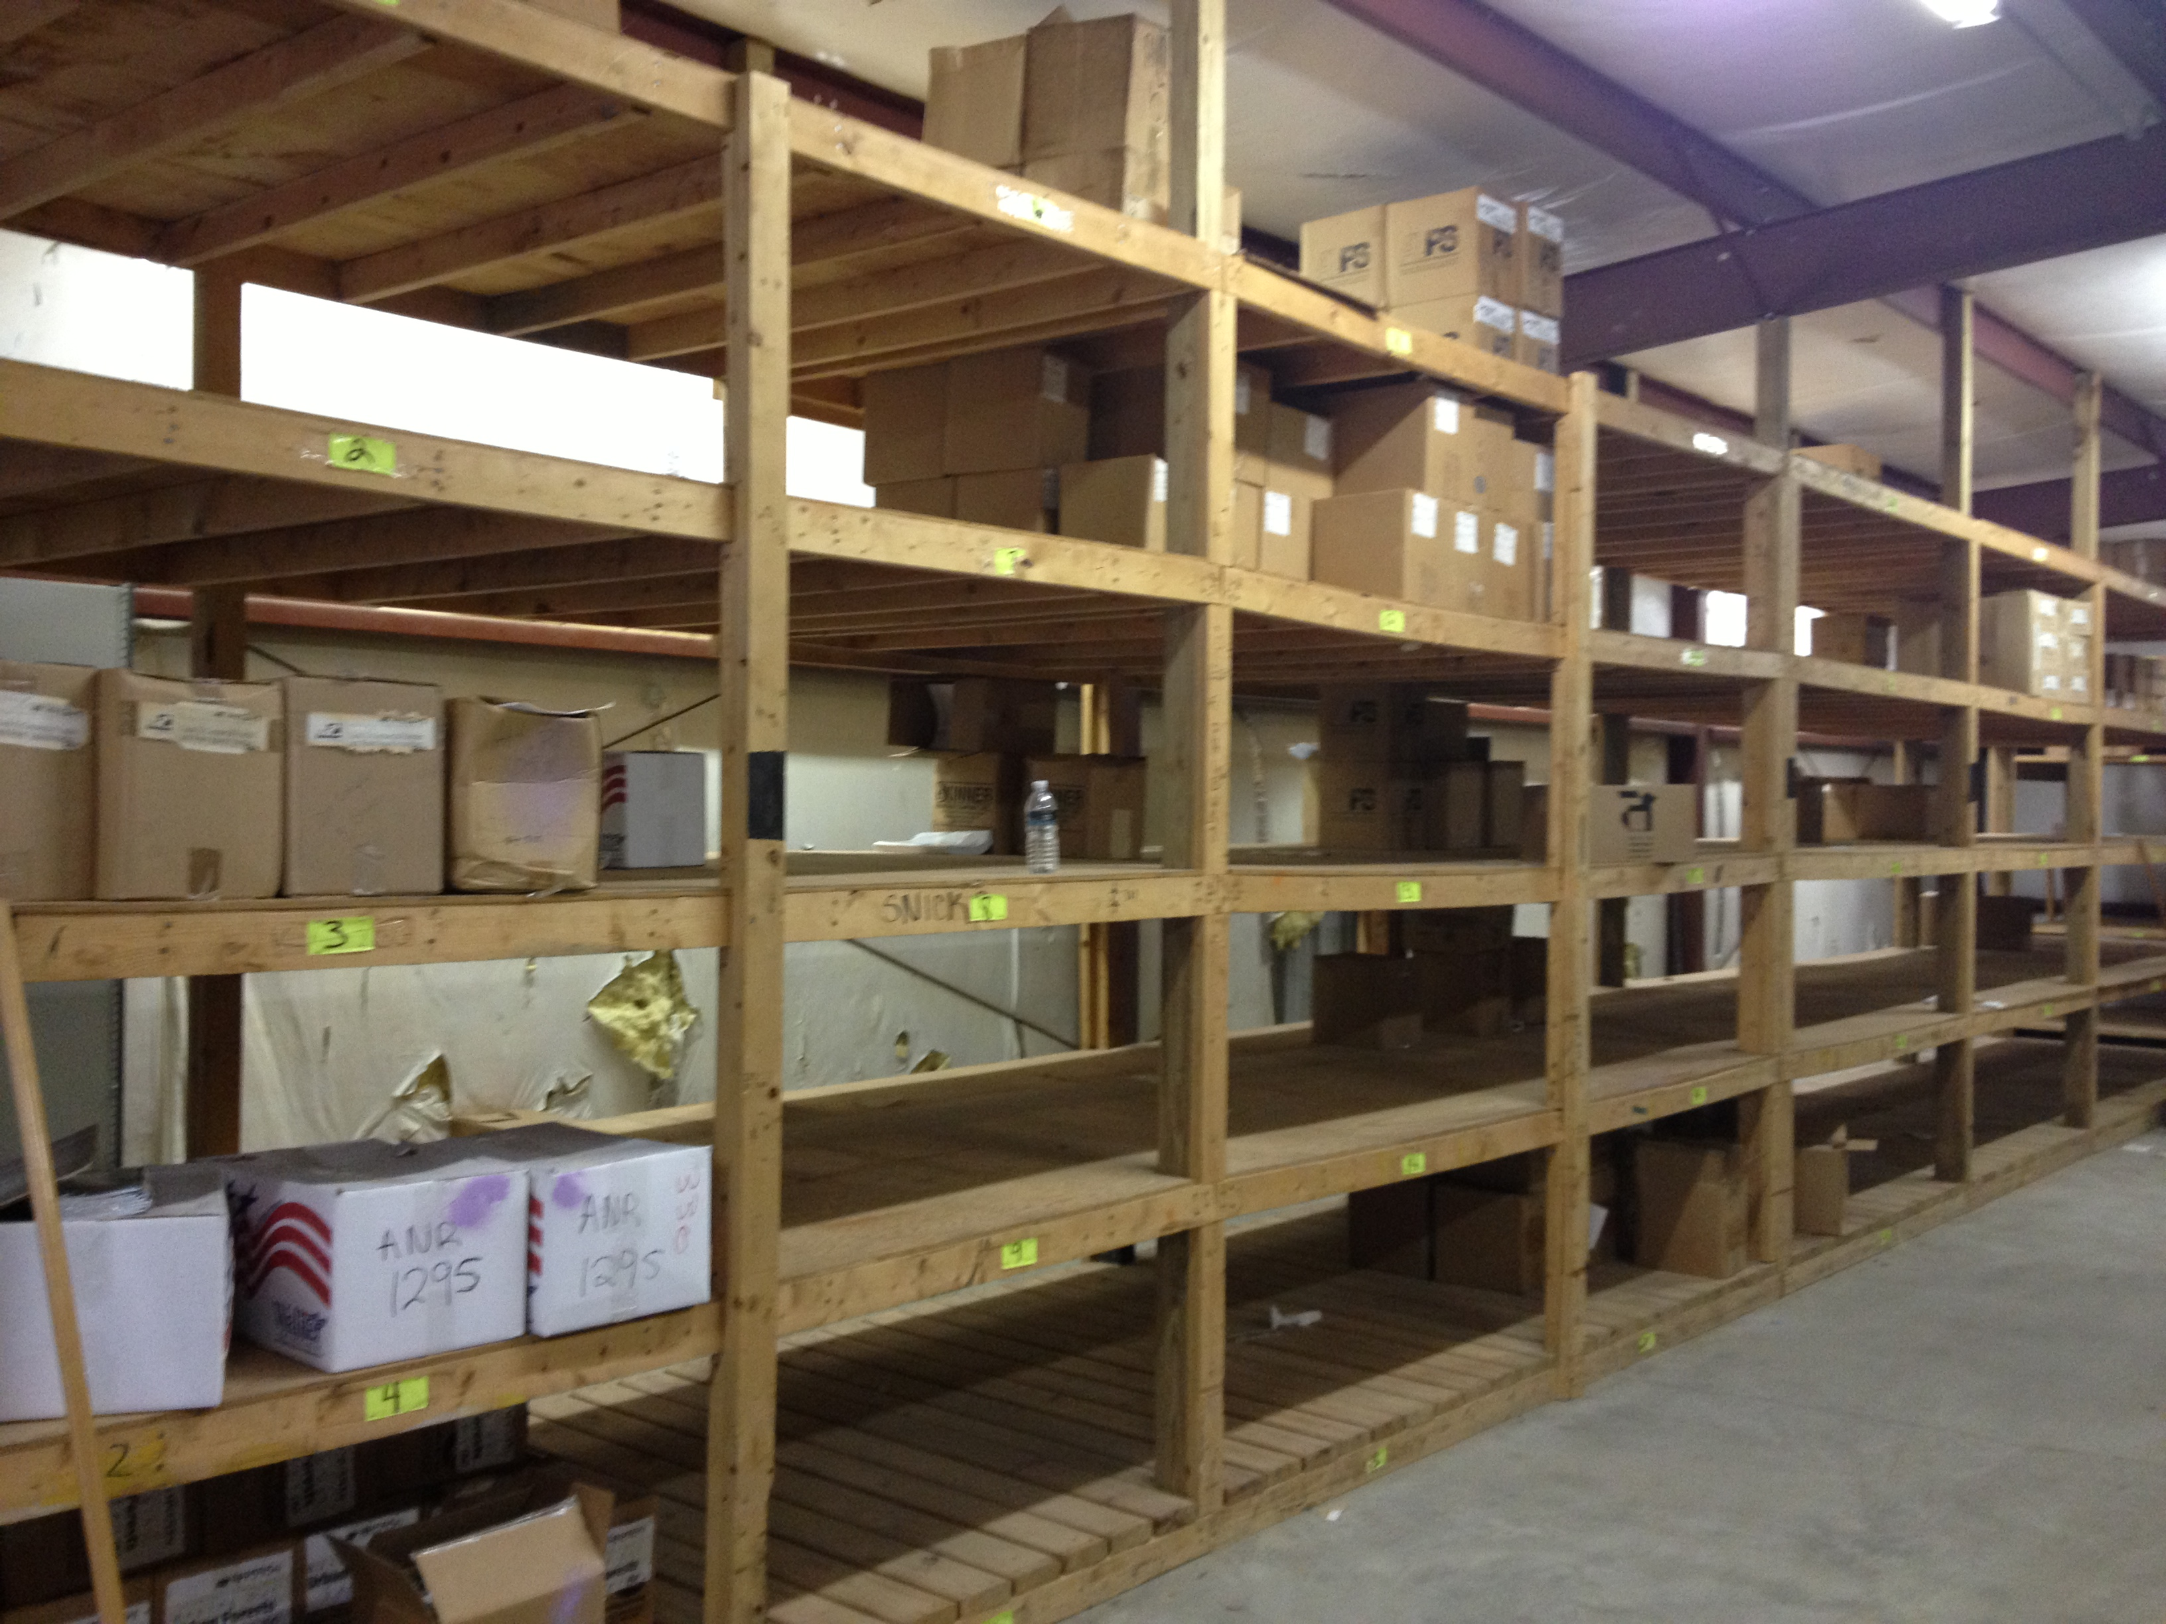
WAREHOUSING & FULFILLMENT
10

Slide 11
GOOD, BETTER, BEST!
Inventory Management
Rev Gen/Cost Recovery
Integrated Marketing
Consistent Branding
Customizable Content
Robust Storefront
Reduction TCO
11

Slide 12
P3
Thank You

